Slide 1
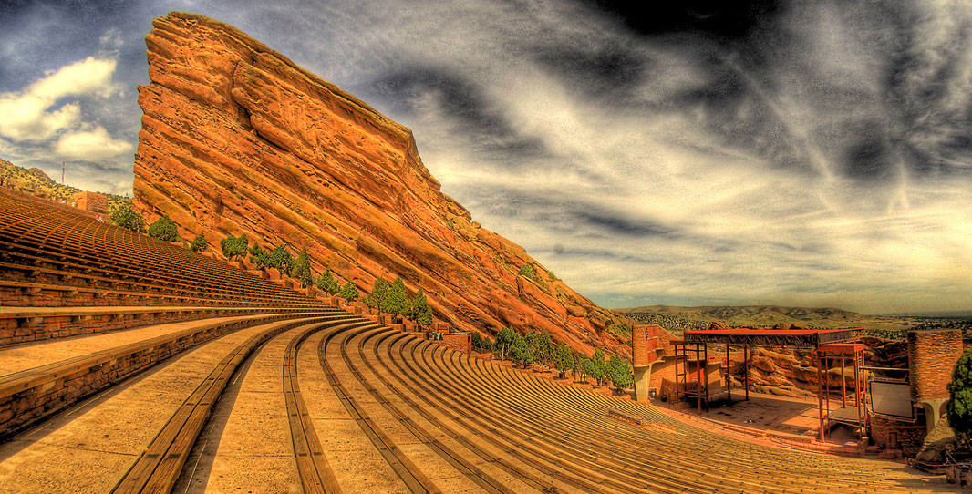
Red Rocks Amphitheatre

Slide 2
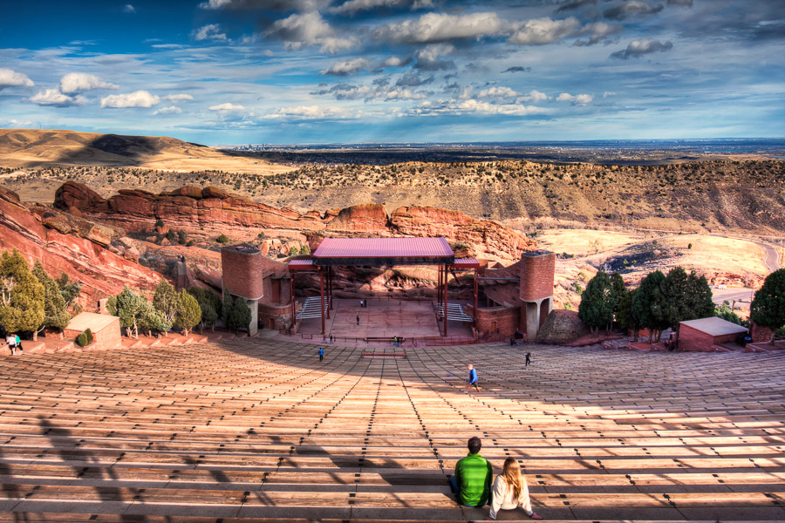
Red Rocks Amphitheatre

Slide 3
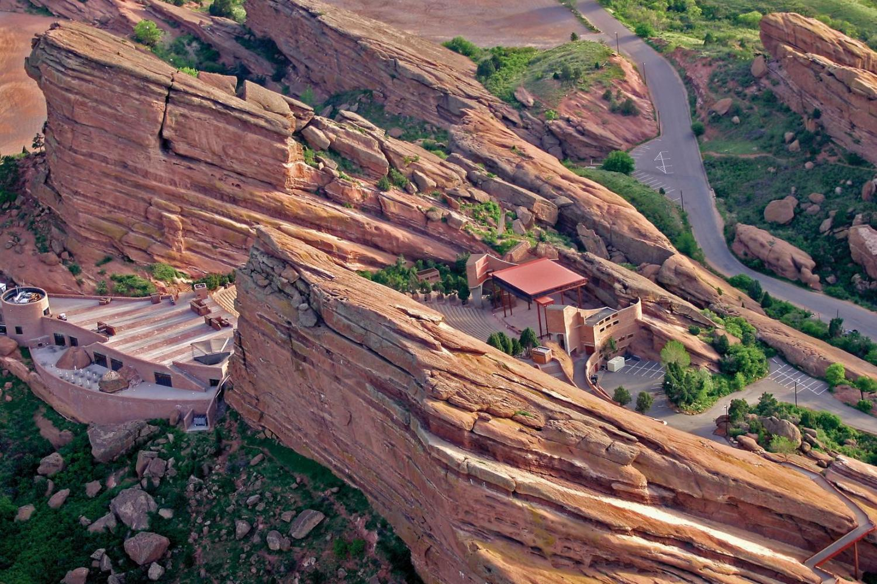
Red Rocks Amphitheatre

Slide 4
Field trip to Red Rocks ……..
NEXT Monday, 10/02!
Rock Structure near Morrison, Colorado
  10 miles west of Denver
Next Monday, 10/02, 11 AM-1 PM
  11 AM: meet at “Trading Post” shop
18300 W Alameda Pkwy, Morrison, CO 80465

Slide 5
Field trip to Red Rocks
Next Monday, 10/02
Amphitheatre
  Bring a Picnic lunch and Socialize and Games?
  ….. HELP! What’s trending in games?
Music Hall of Fame
Hike from “Trading Post” = Amphitheatre
  Wear comfortable shoes

Slide 6
*Unit 3 Test: Europe I
Mrs. Cass Vogel
10th Grade English

Slide 7


Literary Element
(Lit.)
Personification = actions of guitar?
Repetition = impact on reader?
Metaphor?
  5 swords
  = 5 ?
Symbol?

Slide 8
10 A– World Literature
Today’s Objectiv:
Earn highest grade possible on Unit 3 Test! ☺
by improving skills:
*literary analysis
*writing

Slide 9
10 A– World Literature
  1: Literature of the Americas
  2: Literature of the Americas II
    *Portfolio 4-paragraph compare/contrast
  3: Europe I – *No Expository Portfolio
  4: Europe II
  5: Africa
  6: Adventures of Huckleberry Finn

Slide 10
Unit 3: Expository Portfolio dropped
Unit 2: Compare/Contrast
  ******** IMPORTANT ********
  ColoCA NEVER uses 6 Trait Power Write
  I will always send you Handout and post to Message Board

Slide 11
** Unit 3 Test: Europe 1 **
  1-9 : Voc
    altruistic, deviation, piqued, pillaged, etc.
    Flat/round/stock character, illusion, rhyme scheme, etc.
  10-14: “The High School Step Team”
    Infer, imply, themes, characters, relationships
  15-21: from short stories
    Imply, relationships, conflicts, rhyme scheme
  22-26: Grammar
    Phrases: prepositional, appositive, infinitive, gerund, dangling modifier

Slide 12
15-21: from short stories w/text
Read the following lines from the poem "The Divine Comedy“
But I had hardly started when I spied
a leopard in my pathway, lithe and fleet,
all covered with a sleek and spotted hide.
And as I faced it, it would not retreat,
but paced before me and so blocked my way
that more than once I had to turn my feet
The speaker describes the leopard as "lithe and fleet" most likely to imply that
pathway is too narrow for the leopard to pass by.
*leopard appears graceful but can be treacherous.
narrator should run quickly away from the leopard.
leopard is staring at the speaker with a hungry gaze.

Slide 13
“Divine Comedy”rhyme scheme
(written 1312)
And as I faced it, it would not retreat, a
but paced before me and so blocked my way b
that more than once I had to turn my feet a
to retrace my steps. It was the break of day, b
the sun was mounting in the morning sky c
with the same starts as when that whole array b
of lovely things was first given movement by c
divine love. The sweet season of the year d
and the hour made me think that I might try c
--------------------------------------------------
rhyme scheme : aba bcb cda

Slide 14
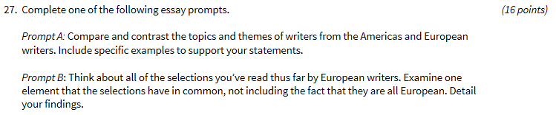
Unit 3 Test -- Essay Question
(16 points)

Slide 15
Unit 3, “Europe I” = War Themes
      hope, hopeless
      disappointment
      loneliness, isolation
      fear
      death, old age

Slide 16
Compare/contrast
2 stories/poems
A: Topic/theme/lesson learned
B: Literary analysis = explain or interpret
author’s word choice
  Figurative language: metaphor, simile, imagery, personification, alliteration, repetition, symbol
  Mood/atmosphere, tone/attitude

Slide 17
TWO 5-sentence Body Paragraph
10 sentences = 16 points
  1) TS – Topic Sentence (subject + opinion).
  2) Proof/support/evidence (11).
  3) Explain/analyze.
  4) Explain/analyze.
  5) Concluding.
  6) TS – Topic Sentence (subject + opinion).
  7) Proof/support/evidence (11).
  8) Explain/analyze.
  9) Explain/analyze.
  10) Concluding.

Slide 18
Internal citation: (23).
Extra Credit Bonus Point
  1) TS – Topic Sentence (subject + opinion).
  2) Proof/support/evidence (11).
  3) Explain/analyze.
  4) Explain/analyze.
  5) Concluding.
  6) TS – Topic Sentence (subject + opinion).
  7) Proof/support/evidence (231).
  8) Explain/analyze.
  9) Explain/analyze.
  10) Concluding.

Slide 19
Literary Analysis
  Figurative language:
    personification
    metaphor
    imagery
    alliteration
    repetition
    symbol
    mood (atmosphere)
    tone (author’s attitude)
  Topic/theme/lesson learned

Slide 20
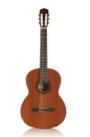
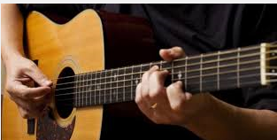
Guitar : Symbolizes

Slide 21
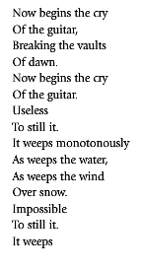
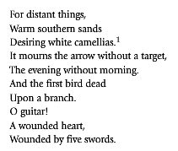

Slide 22
Now begins the cry
Of the guitar,
Breaking the vaults
Of dawn.
Now begins the cry
Of the guitar.
Useless
To still it.
It weeps monotonously
As weeps the water,
As weeps the wind
Over snow.
Impossible
To still it
word choice
imagery
repetition
word choice
1 2 3 4 5
mo-no-ton-ous-ly
alliteration
word choice
Repetition …strumming a guitar

Slide 23
It weeps
For distant things,
Warm southern sands
Desiring white camellias.
It mourns the arrow without a target,
The evening without morning.
And the first bird dead
Upon a branch.
O guitar!
A wounded heart!
Wounded by five swords.
repetition
imagery
alliteration
imagery or symbol
emotion
symbol, emotion
Metaphor
symbol

Slide 24
Metaphor
Metaphor?
  5 swords
  = 5 ?
  …. How do you play guitar?

Slide 25
Guitar : Symbolizes
http://www.metrolyrics.com/while-my-guitar-gently-weeps-lyrics-beatles.html

Slide 26
See you @ Red Rocks
Next Monday, 10/2, at 11AM
Have a productive week! ☺
See you @ Red Rocks …
Next Monday, 10/2, at 11AM!!!

